Slide 1
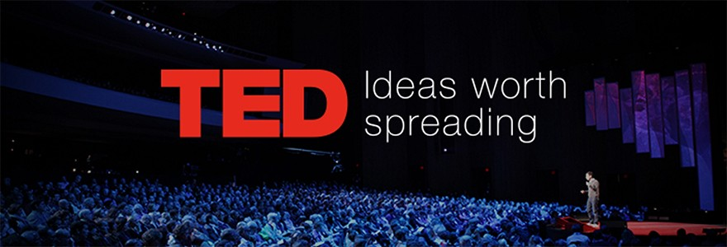
Theme Classification of Ted Talks
Melvin Loh, Madhukar Vatsala, Harshdeep Khola, Tan Minying

Slide 2
Introduction

Slide 3
Data cleaning and extraction

Slide 4
Text pre-processing

Slide 5
Vectorization

Slide 6
Feature engineering and model building

Slide 7
Results

Slide 8
Further considerations

Slide 9
Discussion and limitations

Slide 10
Future work

